Slide 1
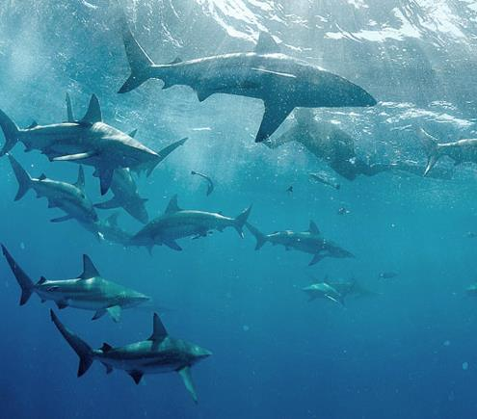
“Confronting the Loan Sharks – Resolving Conflicts” Nehemiah 5:1-19

Slide 2
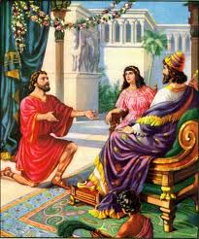
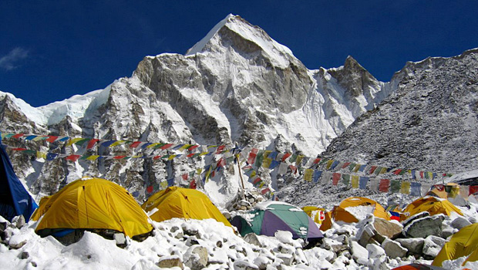
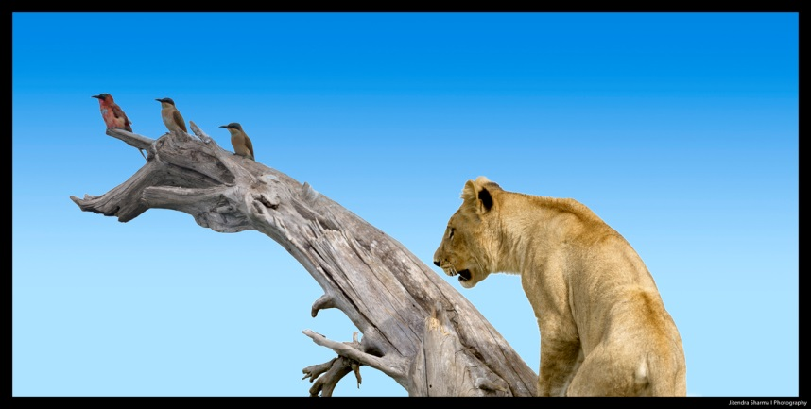
“Confronting the Loan Sharks- Resolving Conflicts” Nehemiah 5:1-19

Slide 3
Nehemiah 5:1-19
Inside turmoil

Slide 4
Nehemiah 5:1-19
Inside turmoil
“In the history of the church we have seen that when the devil couldn’t destroy the church by persecution, the next thing he did was to join it!” (J. Vernon McGee)

Slide 5
Nehemiah 5:1-19
Inside turmoil
Some divisions are inevitable:
False teaching
Unbiblical behaviour

Slide 6
Nehemiah 5:1-19
Inside turmoil
Some divisions are inevitable – however…
Always seek to resolve conflicts:
“make every effort to keep the unity of the Spirit through the bond of peace” (Eph.4:3).
“Let us...make every effort to do what leads to peace and to mutual edification” (Rom 14:19).
“seek peace and pursue it” (1 Peter 3:11).

Slide 7
Nehemiah 5:1-19
Inside turmoil
Nehemiah’s problem – the situation (5:1-5)

Slide 8
Nehemiah 5:1-19
Inside turmoil
Nehemiah’s problem – the situation (5:1-5)
Task nearly complete – only gates needed placing (6:1)

Slide 9
Nehemiah 5:1-19
Inside turmoil
Nehemiah’s problem – the situation (5:1-5)
Task nearly complete – only gates needed placing (6:1)
Breadwinners absent

Slide 10
Nehemiah 5:1-19
Inside turmoil
Nehemiah’s problem – the situation (5:1-5)
Task nearly complete – only gates needed placing (6:1)
Breadwinners absent
Unscrupulous exploitation

Slide 11
Nehemiah 5:1-19
Inside turmoil
Nehemiah’s problem – the situation (5:1-5)
Task nearly complete – only gates needed placing (6:1)
Breadwinners absent
Unscrupulous exploitation
Other problems - famine

Slide 12
Nehemiah 5:1-19
Inside turmoil
Nehemiah’s problem – the situation (5:1-5)
Task nearly complete – only gates needed placing (6:1)
Breadwinners absent
Unscrupulous exploitation
Other problems – famine
− high taxation

Slide 13
Nehemiah 5:1-19
Inside turmoil
Nehemiah’s problem – the situation (5:1-5)
Task nearly complete – only gates needed placing (6:1)
Breadwinners absent
Unscrupulous exploitation
Other problems – famine
− high taxation
− Alexander the Great’s discovery
“When Alexander the Great entered Susa…he found 270 tons of coined gold and about 1200 tons of silver stored up as bullion.” (E. M. Yamauchi: “Persia and the Bible”)

Slide 14
Nehemiah 5:1-19
Inside turmoil
Nehemiah’s problem – the situation (5:1-5)
Task nearly complete – only gates needed placing (6:1)
Breadwinners absent
Unscrupulous exploitation
Other problems
Loan sharks

Slide 15
Nehemiah 5:1-19
Inside turmoil
Nehemiah’s problem – the situation (5:1-5)
Task nearly complete – only gates needed placing (6:1)
Breadwinners absent
Unscrupulous exploitation
Other problems
Loan sharks
“If you lend money to one of my people among you who is needy, do not treat it like a business deal; charge no interest” (Ex.22:25)

Slide 16
Nehemiah 5:1-19
Inside turmoil
Nehemiah’s problem – the situation (5:1-5)
Task nearly complete – only gates needed placing (6:1)
Breadwinners absent
Unscrupulous exploitation
Other problems
Loan sharks
“He does not lend to them at interest or take a profit from them. He withholds his hand from doing wrong and judges fairly between two parties. He follows my decrees and faithfully keeps my laws. That man is righteous; he will surely live, declares the Sovereign Lord” (Ez.18:8-9).

Slide 17
Nehemiah 5:1-19
Inside turmoil
Nehemiah’s problem – the situation (5:1-5)
Biblical principles:
If feel wronged – go to person concerned.

Slide 18
Nehemiah 5:1-19
Inside turmoil
Nehemiah’s problem – the situation (5:1-5)
Biblical principles:
If feel wronged – go to person concerned.
If problem unresolved – go to leaders!

Slide 19
Nehemiah 5:1-19
Inside turmoil
Nehemiah’s problem – the situation (5:1-5)
Nehemiah’s reaction (5:6-7)

Slide 20
Nehemiah 5:1-19
Inside turmoil
Nehemiah’s problem – the situation (5:1-5)
Nehemiah’s reaction (5:6-7)
Righteous anger

Slide 21
Nehemiah 5:1-19
Inside turmoil
Nehemiah’s problem – the situation (5:1-5)
Nehemiah’s reaction (5:6-7)
Righteous anger
Self control

Slide 22
Nehemiah 5:1-19
Inside turmoil
Nehemiah’s problem – the situation (5:1-5)
Nehemiah’s reaction (5:6-7)
Righteous anger
Self control
“He who is slow to anger is better than the mighty, and he who rules his spirit, than he who captures a city.” (Proverbs 16:32)

Slide 23
Nehemiah 5:1-19
Inside turmoil
Nehemiah’s problem – the situation (5:1-5)
Nehemiah’s reaction (5:6-7)
Righteous anger
Self control
Application of biblical principles
Private meeting (v.7a)

Slide 24
Nehemiah 5:1-19
Inside turmoil
Nehemiah’s problem – the situation (5:1-5)
Nehemiah’s reaction (5:6-7)
Righteous anger
Self control
Application of biblical principles
Private meeting (v.7a)
Public hearing (v.7b)

Slide 25
Nehemiah 5:1-19
Inside turmoil
Nehemiah’s problem – the situation (5:1-5)
Nehemiah’s reaction (5:6-7)
Nehemiah’s challenge (5:8-13)

Slide 26
Nehemiah 5:1-19
Inside turmoil
Nehemiah’s problem – the situation (5:1-5)
Nehemiah’s reaction (5:6-7)
Nehemiah’s challenge (5:8-13)
Appeal to conscience (v.8) – “you’re selling your brothers!”

Slide 27
Nehemiah 5:1-19
Inside turmoil
Nehemiah’s problem – the situation (5:1-5)
Nehemiah’s reaction (5:6-7)
Nehemiah’s challenge (5:8-13)
Appeal to conscience (v.8)
Appeal to morality (v.9) “what you are doing is not right!”

Slide 28
Nehemiah 5:1-19
Inside turmoil
Nehemiah’s problem – the situation (5:1-5)
Nehemiah’s reaction (5:6-7)
Nehemiah’s challenge (5:8-13)
Appeal to conscience (v.8)
Appeal to morality (v.9)
Appeal to example (v.10) “I and my brothers …are also lending people money and grain. But let the exacting of usury stop!”

Slide 29
Nehemiah 5:1-19
Inside turmoil
Nehemiah’s problem – the situation (5:1-5)
Nehemiah’s reaction (5:6-7)
Nehemiah’s challenge (5:8-13)
Appeal to conscience (v.8)
Appeal to morality (v.9)
Appeal to example (v.10)
Appeal to commitment (v.11-13) + accountability – a signed pledge.

Slide 30
Nehemiah 5:1-19
Inside turmoil
Nehemiah’s problem – the situation (5:1-5)
Nehemiah’s reaction (5:6-7)
Nehemiah’s challenge (5:8-13)
Nehemiah’s example (5:14-19)

Slide 31
Nehemiah 5:1-19
Inside turmoil
Nehemiah’s problem – the situation (5:1-5)
Nehemiah’s reaction (5:6-7)
Nehemiah’s challenge (5:8-13)
Nehemiah’s example (5:14-19)
His reverence for God (v.15-16)

Slide 32
Nehemiah 5:1-19
Inside turmoil
Nehemiah’s problem – the situation (5:1-5)
Nehemiah’s reaction (5:6-7)
Nehemiah’s challenge (5:8-13)
Nehemiah’s example (5:14-19)
His reverence for God (v.15-16)
His selfless generosity (v.17-18)

Slide 33
Nehemiah 5:1-19
Inside turmoil
Nehemiah’s problem – the situation (5:1-5)
Nehemiah’s reaction (5:6-7)
Nehemiah’s challenge (5:8-13)
Nehemiah’s example (5:14-19)
Conclusions:
Nehemiah’s commitment to God and His work

Slide 34
Nehemiah 5:1-19
Inside turmoil
Nehemiah’s problem – the situation (5:1-5)
Nehemiah’s reaction (5:6-7)
Nehemiah’s challenge (5:8-13)
Nehemiah’s example (5:14-19)
Conclusions:
Nehemiah’s commitment to God and His work
Leaders or followers – we can all learn

Slide 35
Nehemiah 5:1-19
Inside turmoil
Nehemiah’s problem – the situation (5:1-5)
Nehemiah’s reaction (5:6-7)
Nehemiah’s challenge (5:8-13)
Nehemiah’s example (5:14-19)
Conclusions:
Nehemiah’s commitment to God and His work
Leaders or followers – we can all learn
No finger pointing!

